Slide 1
Chapter 4 Computational design of metal systems
An overview on metals
0-Dimensional System: magic clusters
Growth of quantum-sized metallic films
One Dimensional System: Metal Atom Wires
Two Dimensional System: A brief overview of quantum growth
From precise structural control to property optimization
Nano Plasmonics

Slide 2
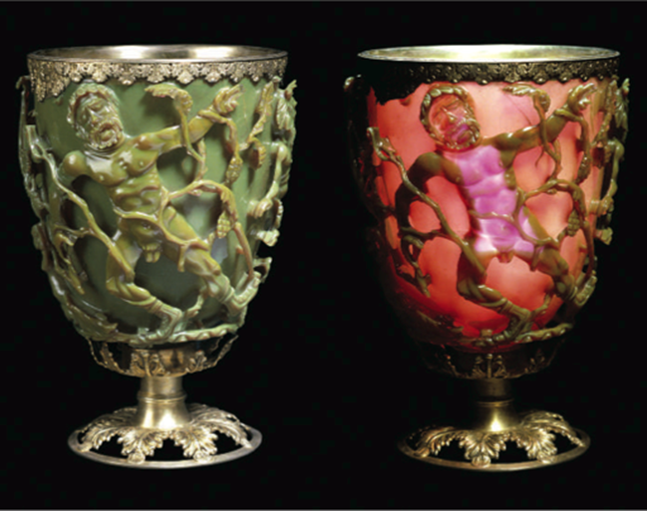
Outline of the Lecture
Fundamental of Plasmonics
Plasmonic Enhancement
Quantum Plasmonics: Landau Damping
Lycurgus cup, AD 400

Slide 3
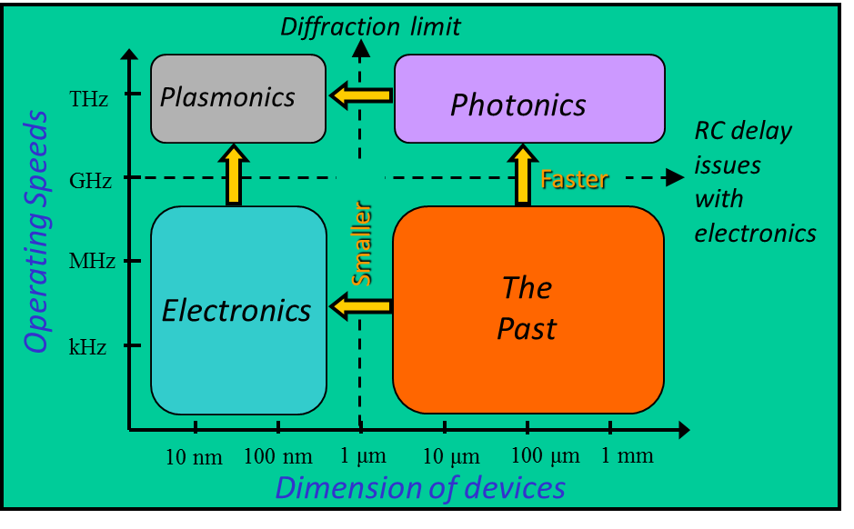
Why Plasmonics?
The long wavelength of light (≈ μm) creates a problem for extending optoelectronics into the nanometer regime.
A possible way out of this dilemma is the conversion of light into plasmons.
They have much shorter wavelengths than light and are able to propagate electronic signals.
Notes:
The spin flip rate is given by an Arrhenius law which describes thermally-activated hopping across an energy barrier ΔE.
Contrary to other thermally-activated processes, such as diffusion, the attempt frequency is not related to vibrations, but to spin rotation (Larmor frequency in the internal magnetic field).

Slide 4
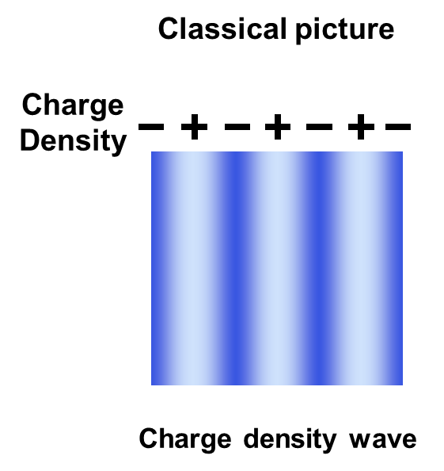
What is a Plasmon ?
A plasmon is a density wave in an electron gas. It is analogous to a sound wave, which is a density wave in a gas consisting of molecules.
Plasmons exist mainly in metals, where electrons are weakly bound to the atoms and free to roam. The free electron gas model provides a good approximation.
The electrons in a metal can wobble like a piece of jelly, pulled back by the attraction of the positive metal ions that they leave behind.
In contrast to the single electron wave function, a plasmon is a collective wave where billions of electrons oscillate in sync.
Notes:
The spin flip rate is given by an Arrhenius law which describes thermally-activated hopping across an energy barrier ΔE.
Contrary to other thermally-activated processes, such as diffusion, the attempt frequency is not related to vibrations, but to spin rotation (Larmor frequency in the internal magnetic field).

Slide 5


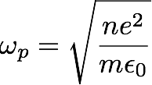
Plasmon: Collective Motion of Electrons
electron
electric field:
restoring force:
oscillation frequency:
ion
typical energy: 5~15eV

Slide 6
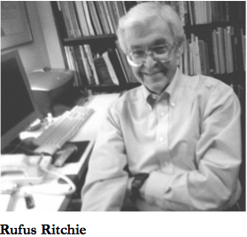


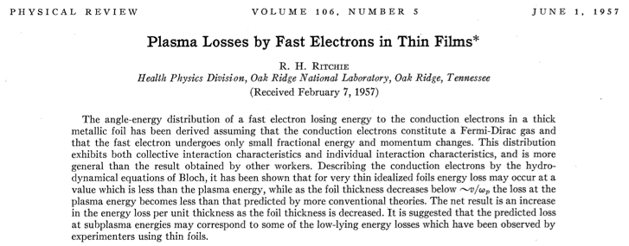
Surface Plasmons in Thin Metal Films
Drude model
Condition
Energy
In thin film

Slide 7
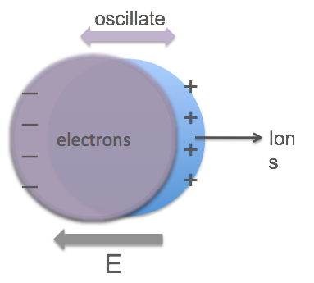
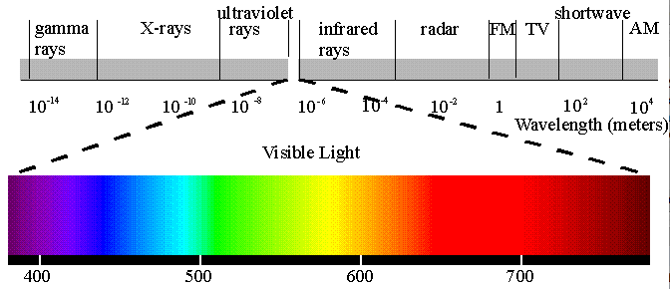

Surface Plasmon in Nanostructures
Classical picture
surface plasmon
energy in
spherical nanoparticles

Slide 8

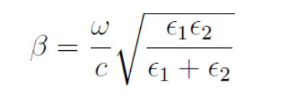
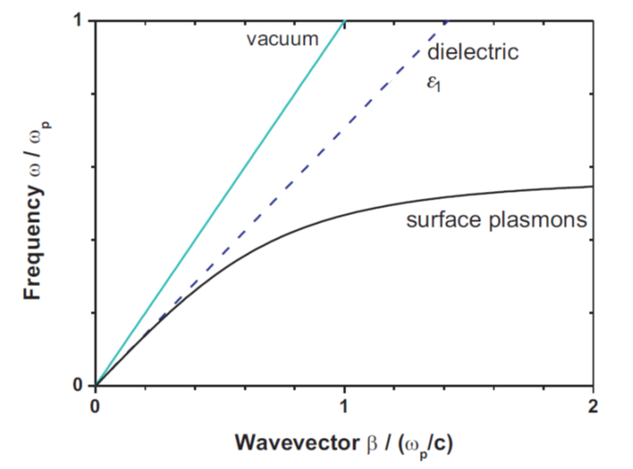
Surface Plasmon Polariton (SPP) and Localized Surface Plasmon (LSP)
SPPs occur at the interface between dielectric and metal, yielding evanescent fields in the two half spaces.

Slide 9
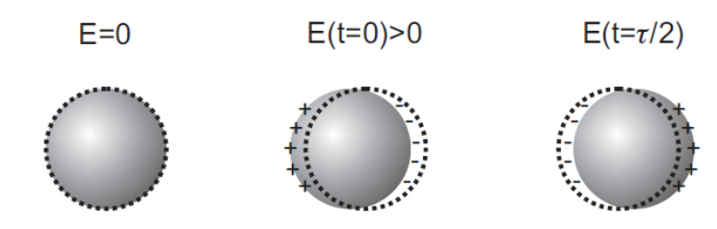
Surface Plasmon Polariton (SPP) and Localized Surface Plasmon (LSP)
LSP

Slide 10
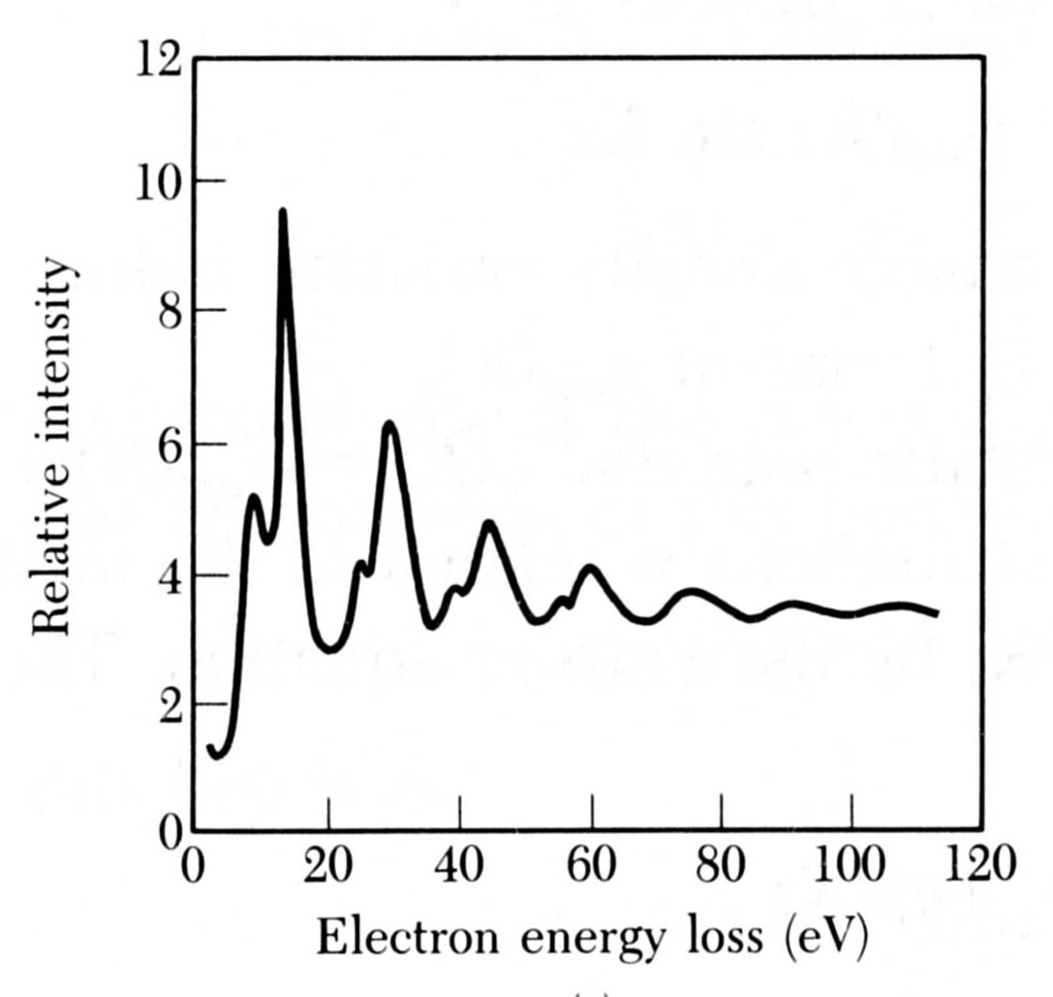
The Plasmon Resonance
Right at the plasmon frequency ω_{p} the electron gas has a resonance, it oscillates violently. This resonance frequency increases with the electron density n , since the electric restoring force is proportional to the displaced charge. Similar to an oscillating spring one obtains the proportionality: ω_{p} ∝ √n
1
The plasmon resonance can be observed in electron energy loss spectroscopy (EELS). Electrons with an energy of 2 keV are reflected from an Al surface and lose energy by exciting 1, 2, 3,… plasmons. The larger peaks at multiples of 15.3 eV are from bulk plasmons, the smaller peaks at multiples of 10.3 eV from surface plasmons.
2
3
4
5
Notes:
The spin flip rate is given by an Arrhenius law which describes thermally-activated hopping across an energy barrier ΔE.
Contrary to other thermally-activated processes, such as diffusion, the attempt frequency is not related to vibrations, but to spin rotation (Larmor frequency in the internal magnetic field).

Slide 11
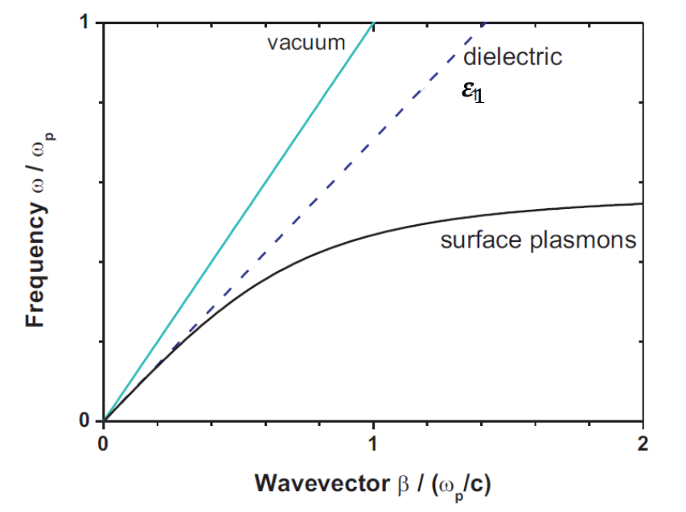

How to Couple Light with Plasmons?
To combine optoelectronics with plasmonics one has to convert light into plasmons. This is not as simple as it sounds.
Bulk plasmons are longitudinal oscillations (parallel to the propagation direction), while photons are transverse (perpendicular to the propagation). They do not match.
Surface plasmons are transverse, but they are mismatched to photons in their momentum. The two E(k) curves never cross. It is possible to provide the necessary momentum by a grating, which transmits the wavevector Δk = 2π/d (d = line spacing) (generally termed momentum compensation).
photonline
$$∆k$$
Notes:
The spin flip rate is given by an Arrhenius law which describes thermally-activated hopping across an energy barrier ΔE.
Contrary to other thermally-activated processes, such as diffusion, the attempt frequency is not related to vibrations, but to spin rotation (Larmor frequency in the internal magnetic field).

Slide 12
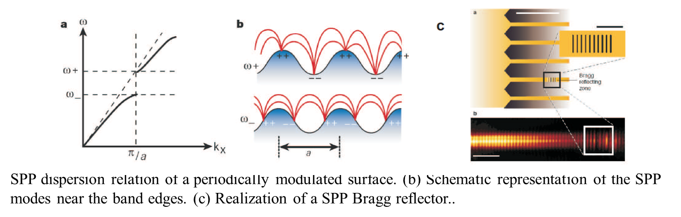

Excitation of surface plasmon polaritons
Prism coupling
Grating coupling
$$β=\frac{ω}{c}\sqrt{ε_{prism}} sinθ$$
Notes:
The spin flip rate is given by an Arrhenius law which describes thermally-activated hopping across an energy barrier ΔE.
Contrary to other thermally-activated processes, such as diffusion, the attempt frequency is not related to vibrations, but to spin rotation (Larmor frequency in the internal magnetic field).

Slide 13
Excitation of surface plasmon polaritons
Excitation using highly focused optical beams
Near-field excitation
Schematic of the excitation of a white-light continuum of SPPs and their observation through an index-matched oil-immersion lens.
Principle of the detection of SPPs with a SNOM probe. (b) and (c) SNOM images, propagation of SPPs along gold nanowires (wavelength 633 nm).
Notes:
The spin flip rate is given by an Arrhenius law which describes thermally-activated hopping across an energy barrier ΔE.
Contrary to other thermally-activated processes, such as diffusion, the attempt frequency is not related to vibrations, but to spin rotation (Larmor frequency in the internal magnetic field).

Slide 14
Low-Dimensional Plasmons in Nanostructures
Single electron waves become quantized by confinement in a nanostructure. Likewise, collective electron waves (i.e., plasmons) are affected by the boundary conditions in a thin film, a nano-rod, or a nano-particle.
Plasmons in metal nanoparticles are often called Mie-resonances (after Gustav Mie). Their resonance energy and color depend strongly on their size, similar to the color change induced in semiconductor nanoparticles by confinement of single electrons. In both cases, smaller particles have higher resonance energy.
Notes:
The spin flip rate is given by an Arrhenius law which describes thermally-activated hopping across an energy barrier ΔE.
Contrary to other thermally-activated processes, such as diffusion, the attempt frequency is not related to vibrations, but to spin rotation (Larmor frequency in the internal magnetic field).

Slide 15
Fundamental of Plasmonics
Plasmonic Enhancement
Quantum Plasmonics: Landau Damping

Slide 16
Contributed by
Prof. Zhenyu Zhang U of Tennessee => ICQD/USTC
Dr. Ke Zhao U of Tennessee => Rice U
Dr. Xiaoguang Li U of Tennessee => Fudan U/USTC
Dr. Youlin Song Zhengzhou U/U of Tennessee
=> Henan College of Education
Dr. Bo Persson Julich Center, Germany
Dr. Hongxing Xu IOP/CAS & Lund U
Dr. Baohua Gu ORNL
Dr. Nahla Hatab ORNL
Dr. Claudia Troparevsky ORNL/U of Tennessee
Dr. Di Xiao ORNL
Dr. Yu Jia Zhengzhou U/ORNL
Dr. Gyula Eres ORNL
Dr. Chun-Hway Hsueh UT=>Taiwan
Dr. Adolfo Eguiluz U of Tennessee

Slide 17
Surface Enhanced Raman Scattering (SERS)
Fleischman, Hendra, McQuillan, (1974)
Jeamaire and Van Duyne,
(1977)
Enhancement factor:
10⁵ - 10⁶.
Challenges:
(a) still too weak to detect single molecules , making SERS an ensemble
average technique
(b) too few SERS-active “hot spots”
(c) lack of control: searching for “hot spots” by trial-and-error
Standing Puzzle: underlying mechanism for SERS still unclear

Slide 18
Systems, Scales, Approaches, Main Findings
molecule
(2-3Å)
S:1-3nm
d~λ
S:1-10Å
λ:10²-10³ nm
b~λ
System:
Molecule on
single substrate
Nanoparticle dimer
Around touching contact
1D & 2D Nanoparticle
dimer arrays
Approach:
Quantum
many-body
theory
ab initio
density functional
theory of real atom
Classical Electromagnetic
theory
Science:
New chemical
effect
Optimal gap size,
magentic moment
localized surface plasmon + photonic effect (SERS)

Slide 19

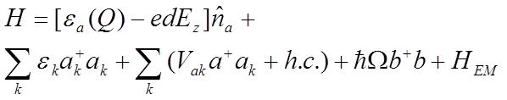
Prevailing Mechanism: Perpendicular Electric Field
Q
electron energy
in molecule
photon-electron coupling
Molecule
photon energy
e⁻
Metal Substrate
electron energy
in metal
charge transfer
molecule vibration
B. N. J. Persson, Chem. Phys. Lett. 82, 561 (1981)
Estimated chemical effect: M_{CH} ~ 10²
Selection Rule: Electric Field Parallel to Vibration

Slide 20
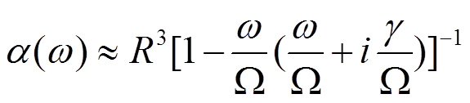

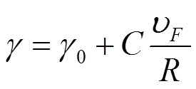
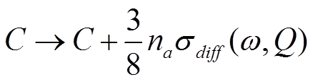
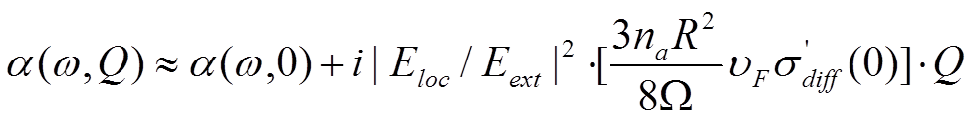

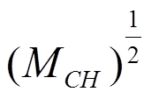
New Enhancement Mechanism from Parallel Electric Field
B. N. J. Persson, K. Zhao, and Z. Y. Zhang, Phys. Rev. Lett. 96, 207401 (2006)
Q
Nanoparticle
Molecule
e⁻
R
bulk damping
surface damping
Metal
Substrate
C = Vacuum Value (no molecule)
(with molecule)
Estimated Chemical Enhancement M_{CH} :
10² for nanoparticle,
6×10³ for flat surface
Selection Rule: Electric Field Perpendicular to Vibration.

Slide 21
Comparison of The Two Mechanisms for
Chemical Enhancement
Model | Previous | New
Vibration Relative to Surface | Best perpendicular | Best perpendicular
Electric Field Relative to Surface | Perpendicular | Parallel
Electric Field Relative to Vibration | Parallel | Perpendicular
Enhancement | 10² on any kind of surface geometry | 10² on small nanoparticle, 6×10³ on flat surface

Slide 22
Systems, Scales, Approaches, Main Findings
molecule
(2-3Å)
S:1-3nm
S:1-10Å
d~λ
λ:10²-10³ nm
b~λ
System:
Molecule on
single substrate
Nanoparticle dimer
Around touching contact
1D & 2D Nanoparticle
dimer arrays
Approach:
Quantum
many-body
theory
ab initio
density functional
theory of real atom
Classical Electromagnetic
theory
Science:
New chemical
effect
Optimal gap size,
magentic moment
localized surface plasmon + photonic effect (SERS)

Slide 23
Strong vs Weak Coupling of a Nanoparticle Dimer
Different physics expected for a dimer in different electronic coupling regimes.
Large gap
Weak Coupling
Small gap (touching contact)
Strong Coupling
electron cloud
Optical
Magnetic
Transport
Chemical
…
…
All expected to be different in two regimes
Notes:
23

Slide 24
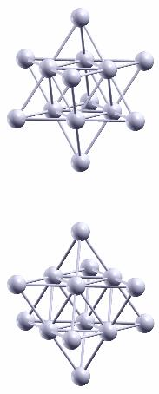
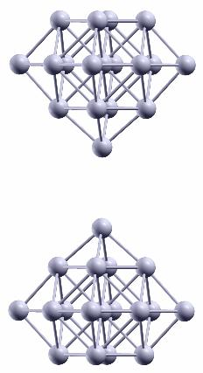
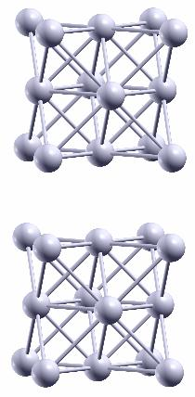
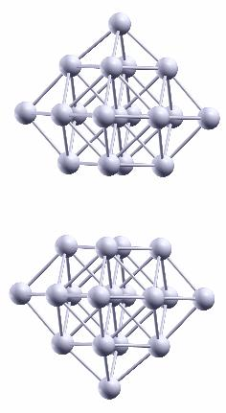
Silver Nanoparticle Dimers
(Ag₁₄)_{2,t-t}
(Ag₁₈)_{2,t-t}
(Ag₁₄)_{2,p-p}
(Ag₁₈)_{2,t-t}
d
d
d
d
[111]
S
[100]
[100]
S
[100]
S
S
d=2.2Å
d=1.9Å
d=2.0Å
d=1.9Å
t-t: tip-tip orientation p-p: plane-plane orientation
Real Atoms Study
K. Zhao, M. C. Troparevsky, D. Xiao, A. Eguiluz, ZZ, PRL 102, 186804 (2009)
Notes:
24

Slide 25
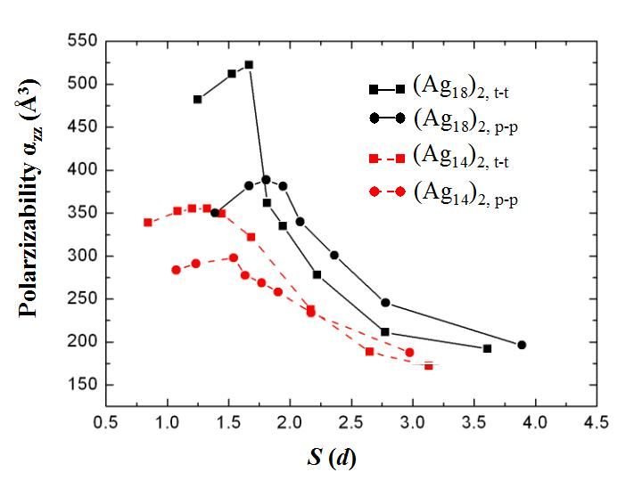
Optimal Gap Size (Electrical Linear Response)
S
Optimal Gap Size
P_{z}: dipole moment
S (unit: interlayer spacing d)
Existence of an optimal gap size in all types of dimers
Higher maximum polarizability in tip-tip orientation
Jellium Model (Nordlander’s group: Nano Lett 09): Much larger nanoparticle dimers
Notes:
25

Slide 26
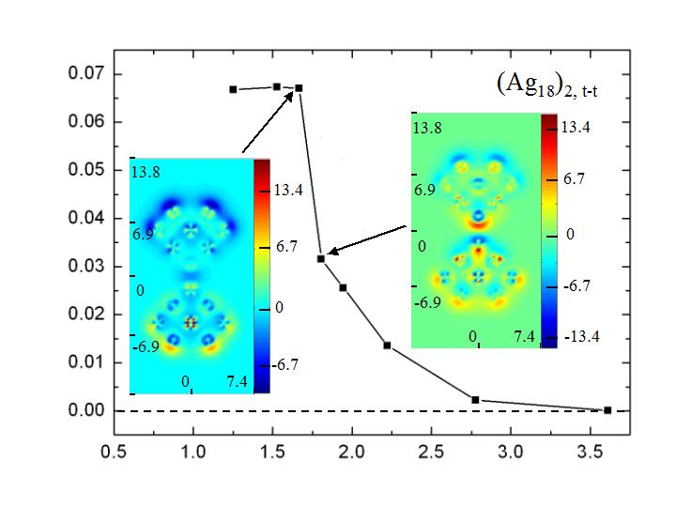


“Bond” Breaking Picture for Optimal Gap Size
Before “bond” breaks
(small S)
“bond”: a channel allowing charge
to flow between nanoparticles
After “bond” breaks
(large S)
Transfered Charge (e)
S
Polarizability increases
with increasing S
S (unit: interlayer spacing d)
Polarizability decreases
with increasing S
Classical picture: monotoneously decreasing
Notes:
26

Slide 27
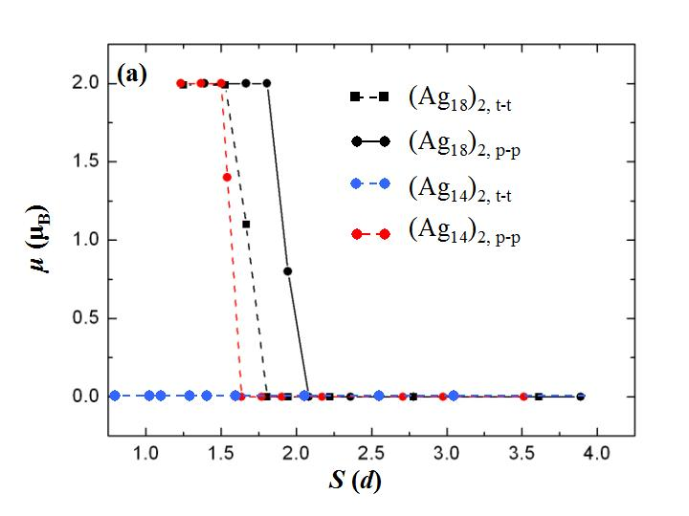
Emergent Magnetic Moment
Zero Field
S
Magnetic Moment (μ_{B})
Optimal
Gap Size
S (unit: interlayer spacing d)
Even nonmagnetic nanoparticles may develop a net magnetic moment for S smaller than optimal gap size (OGS)
Notes:
27

Slide 28
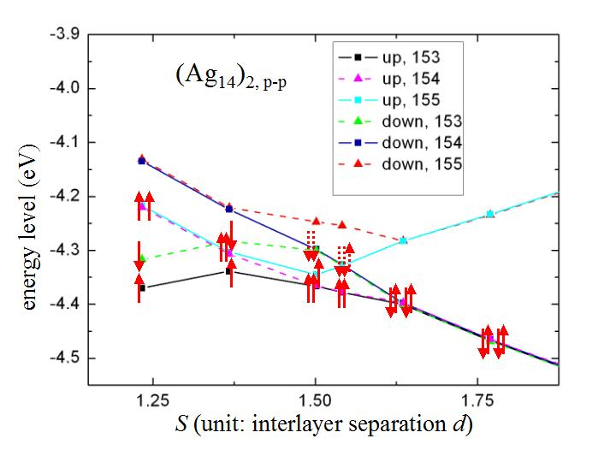
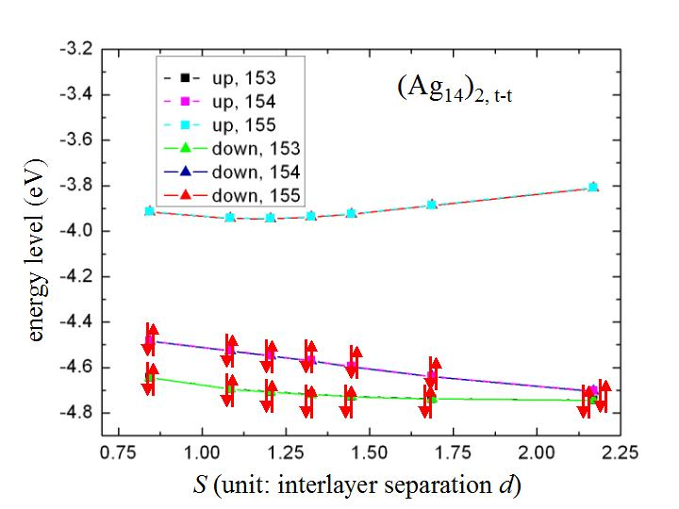
Mechanism for Emergent Magnetism
spin down
LUMO
spin up
energy level
zero magnetic
moment
energy level (eV)
e
e
e
e
nonzero
magnetic moment
HOMO
S
S (unit: interlayer spacing d)
energy level (eV)
S (unit: interlayer spacing d)
Notes:
28

Slide 29
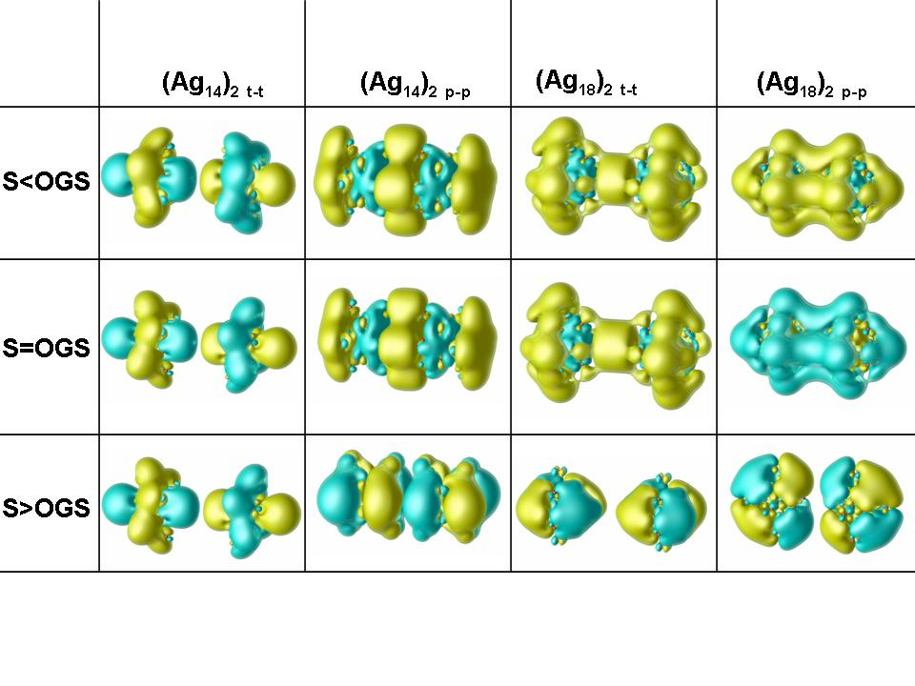
Understanding Coupling from Orbital View
HOMO
M. C. Troparevsky, K. Zhao, D. Xiao, A. Eguiluz, Z. Y. Zhang, Phys. Rev. B (2010)

Slide 30

Nonlinear Dielectric Response
(Å³)
unit: d
S
Nonlinear starting from
a weak field
M. C. Troparevsky, K. Zhao, D. Xiao, Z. Y. Zhang, A. Eguiluz, Nano Lett. 9, 4452 (2009)

Slide 31
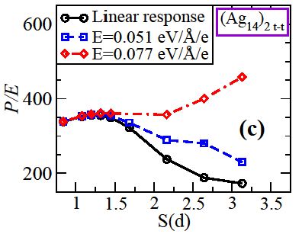
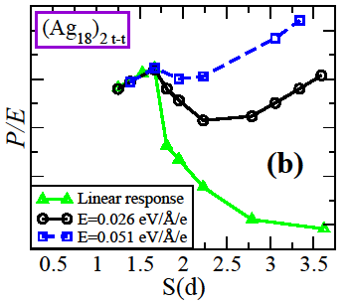
Increasing Dipole Moment in Nonlinear Regime
(Å³)
600
400
200
Nonlinear Regime
Charge Transfer Between NP

Slide 32
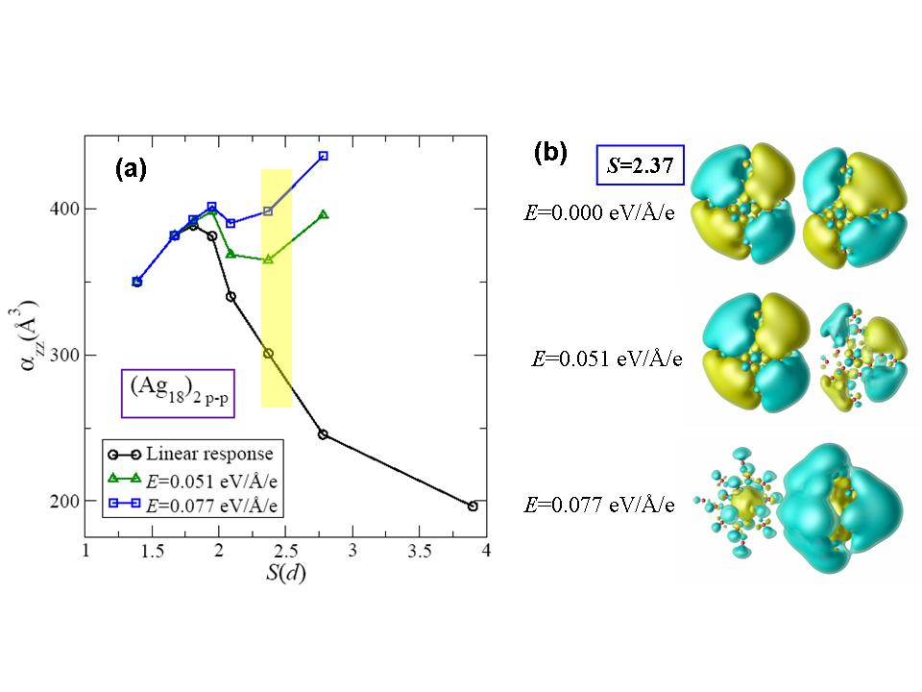
Orbitals of Nonlinear Regime
(Å³)
P/E
The transition to the nonlinear regime is featured by the change of character of the HOMO.

Slide 33
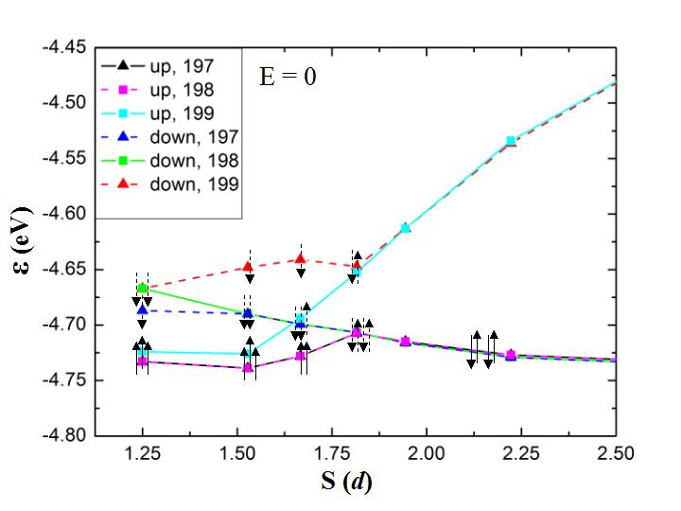
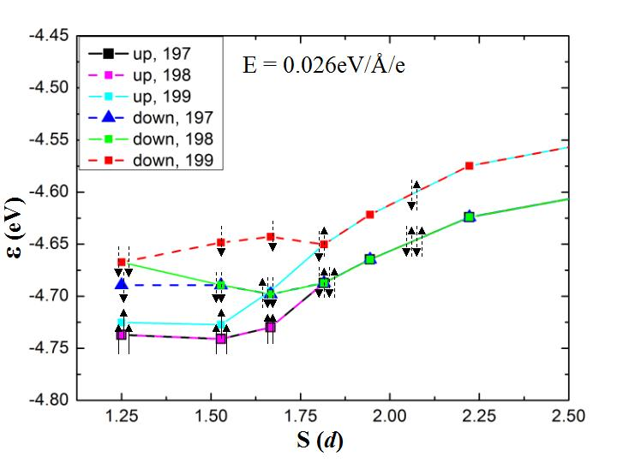
Microscopic Mechanism of Nonlinear Response
No field
Weak Field
Energy
High Field Energy
fractionally occupied
LUMO
empty
empty
Breakdown of adiabaticity,
entering nonlinear regime
HOMO
(Ag₁₈)_{2,t-t}
(Ag₁₈)_{2,t-t}

Slide 34
Interplay Between Electric and Magnetic Degree of Freedom
Linear response
Nonlinear response
(Ag₁₈)_{2,t-t}
Nanoparticle Aggregates as Potential Multiferroic Materials

Slide 35
Systems, Scales, Approaches, Main Findings
molecule
(2-3Å)
S:1-3nm
S:1-10Å
d~λ
λ:10²-10³ nm
b~λ
System:
Molecule on
single substrate
Nanoparticle dimer
Around touching contact
1D & 2D Nanoparticle
dimer arrays
Approach:
Quantum
many-body
theory
Real atom ab initio
density functional
theory
Classical Electromagnetic
theory
Science:
New chemical
effect
Optimal gap size,
magentic moment
localized surface plasmon + photonic effect (SERS)

Slide 36



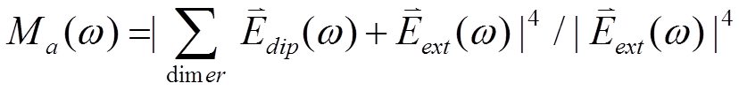
Collective Photonic Effect for SERS
dipole moment
=
×
By Mie theory
=
×

Slide 37

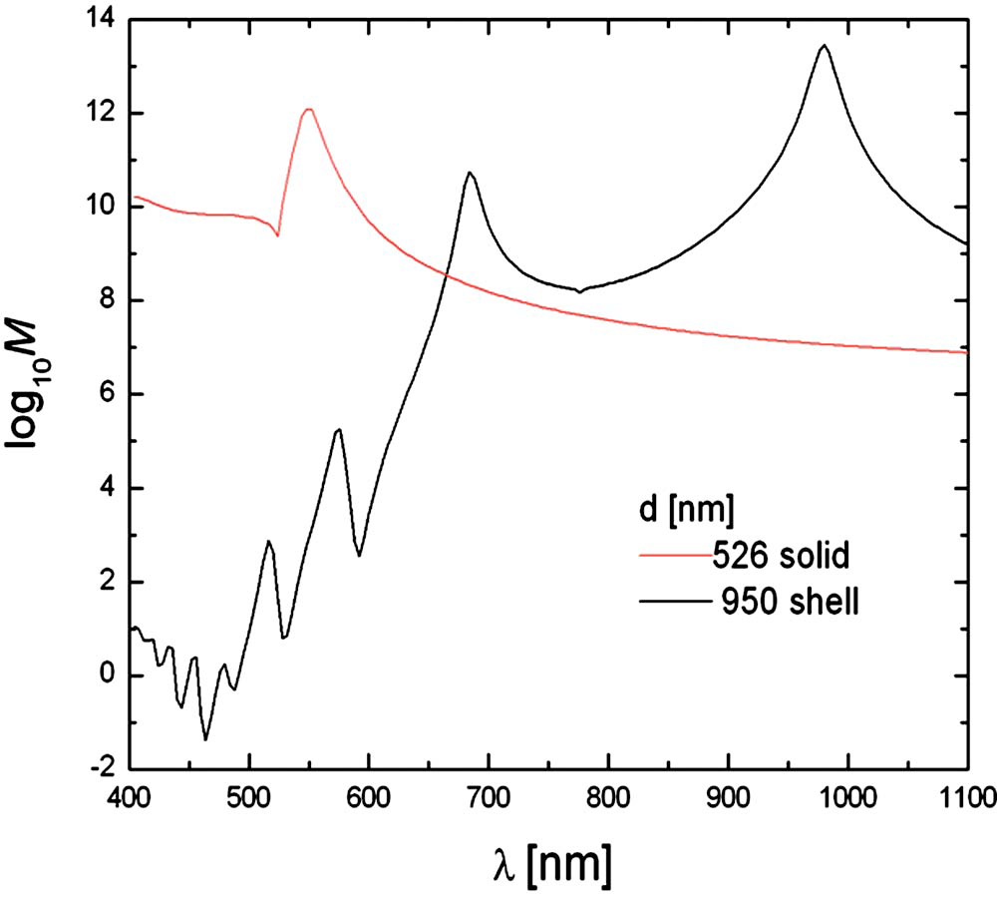
Advantages of Nanoshell: Higher Enhancement
K. Zhao, H. X. Xu, B. H. Gu, and ZZ, J. Chem. Phys. 125, 081102 (2006)
38nm
(35,38) nm
d
log₁₀M_{EM}
silica core
silver shell
Nanoshell:
Halas & Co.

Slide 38

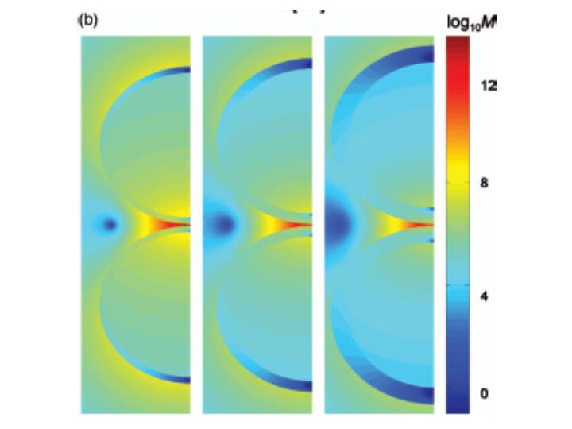
Advantages of Nanoshell: Extra Tunability
(r₁,r₂)
d
log₁₀M_{EM}
12
8
log₁₀M_{EM}
r₁=35 [nm]
r₂ [nm]
d [nm]
701nm
4
785nm
950nm
0
Hot Volume (M_{EM}>10¹⁰ )~ 1720 nm³
at Resonance

Slide 39
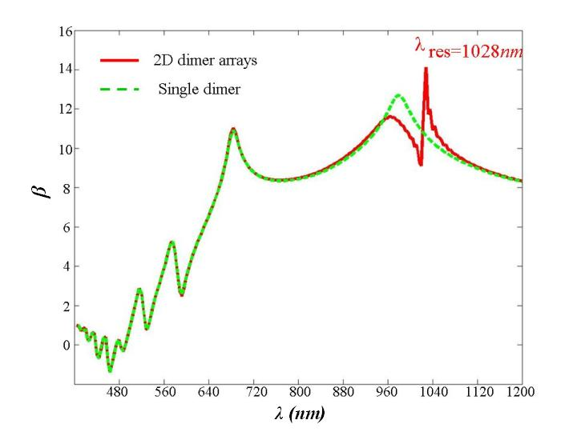

Giant Electromagnetic Enhancement
total dimer number: 400
2D dimer array
dimer
total dimer
number in
each chain:
225
log₁₀M_{EM}
d
chain l
chain l+1
480 640 800 960 1120
λ [nm]
Additional enhancement on top of isolated dimer

Slide 40
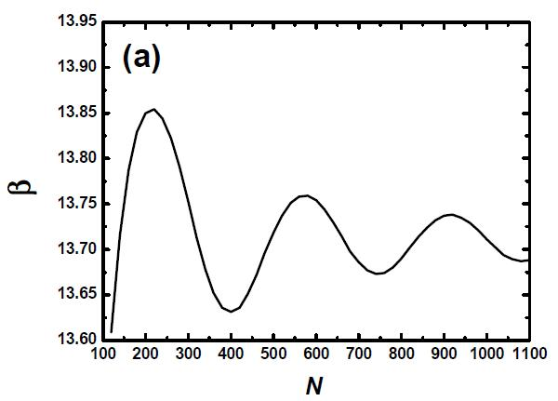
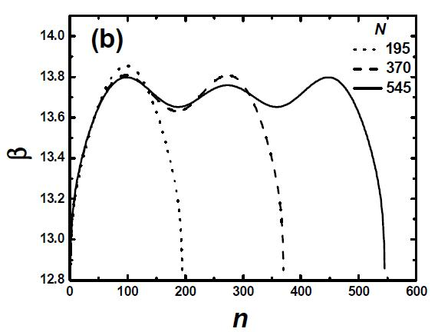

Finite Size Effect (Oscillatory Enhancement) in 1D Dimer Arrays
dimer index
n
1
log₁₀M_{EM}
log₁₀M_{EM}
β
1
N/2
N
N/2
N
Type I oscillation ΔN refers to
enhancement with array length
Type II oscillation Δn refers to
enhancement along one fixed
array
ΔN 2×Δn
N fixed
Y. L. Song, K. Zhao, and Z. Y. Zhang,
J. Chem. Phys. 129, 204506 (2008)

Slide 41

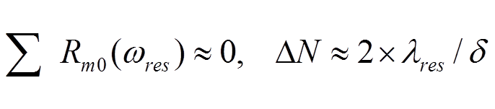




Mechanism of Oscillatory Enhancement
The oscillation with total dimer number:
Approximation: All dipoles feel the same field
dipole index:
d
0
m
dipole field from m to 0:
Similar mechanism responsible for the oscillation along a fixed array,
but oscillation period

Slide 42
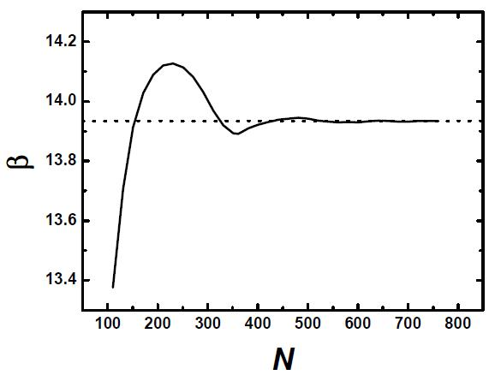

Constant Enhancement in 2D Dimer Arrays
1
N/2
log₁₀M_{EM}
N
Enhancement essentially
a constant for large N

Slide 43
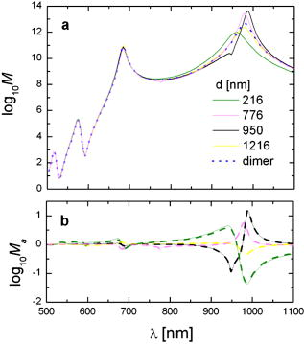
Collective photonic coupling effect – Fantasy, or Reality???
Highest EM enhancement: 4.5×10¹³
Additional enhancements due to long-range photonic effects
Zhao, Xu, Gu, Zhang, 2006,
J. Chem. Phys. 125, 081102.
Notes:
Closely packed nanostructure not necessarily the best

Slide 44
Collectivephotonic coupling effect – Fantasy, or Reality???
Highest EM enhancement: 4.5×10¹³
Additional enhancements due to long-range photonic effects
Zhao, Xu, Gu, Zhang, 2006,
J. Chem. Phys. 125, 081102.
Experimental Proof using gold bowties
Notes:
Closely packed nanostructure not necessarily the best

Slide 45
EBL and Reactive Ion Etching (RIE)
EBL generates high resolution features with arbitrary patterns
Resist
Si wafer
Developer
Positive Resist- expose part is removed; negative resist-expose part remains
Deposition of a Cr adhesion layer (8 nm)
Lift
Off
Remover
RIE
RIE used to generate deep trench structures on silicon substrate
Au Deposition
Notes:
Conventional techniques vs Improved EBL technique

Slide 46
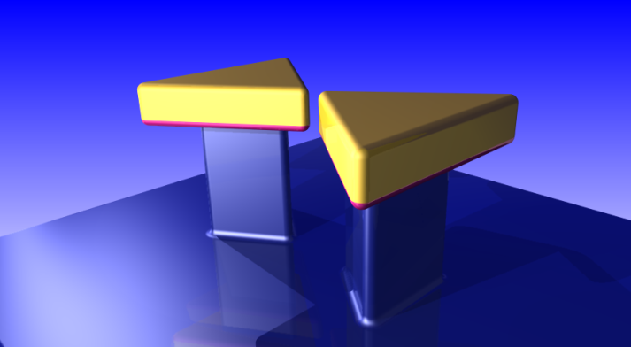
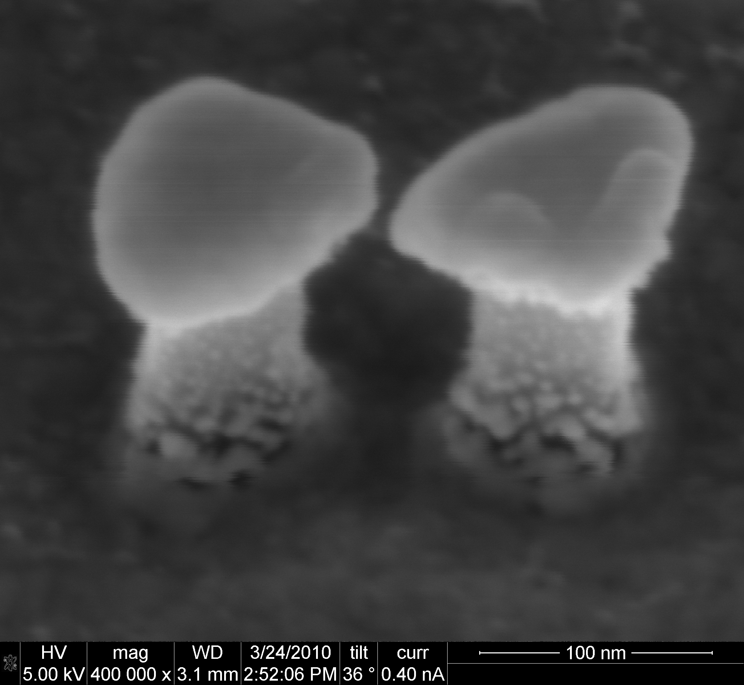
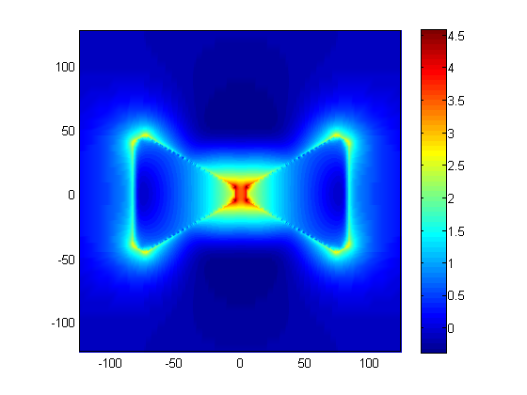
Fabrication of Elevated Gold Nano-Bowtie
7.5 nm
Close the gap beyond the EBL limit
Tunable gap size, density, shape and morphologies
Fully decoupled from substrate
Serving as a plasmonic nanoantenna

Slide 47
Effect of Nanostructures – Size and shape
Bowtie gives the best performance
Notes:
Similar to previous studies

Slide 48
Effect of Si Post – FDTD Simulations
E field enhanced by using elevated bowties

Slide 49
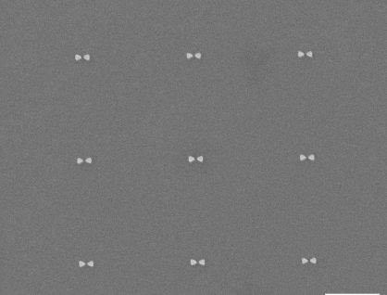
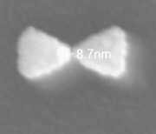
Systematic studies of Gap Size on SERS
100 nm
100 nm
100 nm
1
1
µ
µ
m
m

Slide 50
Gap-dependent SERS enhancement
100 nm
100 nm
100 nm
1
1
µ
µ
m
m
Notes:
Enhancement on a single bowtie

Slide 51
Power Law Dependent SERS on Gap Size
(b)
|E|⁴ = Ad^{m}
SERS enhancement
m = -2.2
A, m=-2.29
B, m=-2.19
C, m=-2.26
E ~ d^{-0.55}
When gap size is sufficiently small, E only
weakly depends on gap size (d)

Slide 52
Power Law Dependent SERS on Gap Size
FDTD Simulation
closely
correlates
With
experimental
results
Tip sharpness
w affect on E
Max |E|⁴ enhancement
Notes:
Not been reported previously

Slide 53
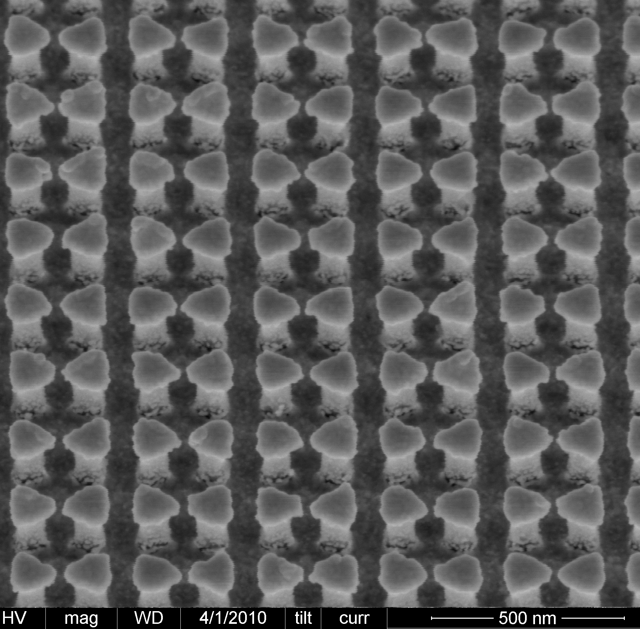

Collective Photonic Effect
A ccd = rrd = 2 μm
C ccd = rrd = 300 nm
B, 785 nm
2 μm
B ccd = 785 nm, rrd = 2 μm
(a)
2 μm
A, 2 μm
C, 300 nm

Slide 54

Concurrent Multiscale Approach
Classical EM
for separated nanoparticles
DFT for touching
contact or molecular junction, but only small systems
Concurrent Multiscale
Classical
Charge
Matching
DFT

Slide 55


Quantum Plasmonics
Xiaoguang Li (李晓光)
Di Xiao（肖笛）
Jian Shen（沈健）
Hanno Weitering
Zhenyu Zhang（张振宇）
Fudan University
University of Tennessee, Knoxville
University of Sci. & Tech. of China
03/05/2012

Slide 56

Go Beyond The Classical Study
Quantum picture
Classical picture
Charge
Density
Charge density wave
A quasiparticle of the excited system
Collective Motion of Electrons

Slide 57



Energy Tunability of Plasmon in Nanostructures
Hybridization model
E. Prodan and P. Nordlander and N. J. Halas,
Nano Letters, 3, 1411--1415, (2003)
E. Prodan and C. Radloff and N. J. Halas and P. Nordlander,
Science, 302, 419-422, (2003)

Slide 58



Spectra of Single Electron-Hole Pairs and Collective Plasmon Mode
Upper boundary
Small q
q
electron-hole
pairs
Lower boundary
plasmon
Large q
Upper boundary
Lower boundary
q
Bulk Plasmon
Landau Damping
Transition from plasmon to single electron-hole pair
longitudinal wave
can not couple with light

Slide 59




Linewidth of Plasmon in Nanostructures
We expect high
Quality Factor:
  Plasmon to photon
    radiation damping (solved with classical theory)
  Plasmon to electron-hole pairs
    intrinsic Landau damping (quantum is needed)
Drude model
dielectric function:
Size dependence of intrinsic damping with quantum study
intrinsic damping
input parameter
R
spherical particle
intrinsic width
bulk property
A. Kawabata and R. Kubo, JPSJ, 21, 1765-1772, (1966)
confinement
U. Kreibig and C. v. Fragstein, Z. Physik, 224, 307--323, (1969)

Slide 60

Surface scattering and Landau damping
Classical picture
Quantum picture
electron-hole
pairs
A. Kawabata and R. Kubo, Journal of the Physical Society of Japan, 21, 1765-1772, (1966)

Slide 61
Methods
Homemade code
  Ag (Wigner-Seitz radius rs=3.0 a.u.)
  the monolayer thickness 0.236 nm in Ag(111) direction as the unit of length
Ground state
  Local Density Approximation
  Jellium background
Excited state
  Random Phase Approximation
    real-space basis set
      scan energy for absorption peaks, limited by energy broadening
    electron-hole pair basis set
      solve the energy of plasmon modes directly

Slide 62



Thickness Dependence of Plasmon in Thin Films
thin film
interacting
Energy (eV)
Oscillatory Linewidth
Absorption
thickness increasing
Linewidth (eV)
Energy (eV)
initial broadening
Thickness (monolayer)

Slide 63







Comparison of Two Basis Sets
Real-space basis
Electron-hole basis
density-density response function
state-state response function
energy broadening
interaction
interaction
absorption
Energy eigenstates and corresponding absorption
absorption
absorption
Energy (eV)
Energy (eV)

Slide 64



Band Structures and Electron-Hole Absorption Spectra in Thin Films
Absorption spectrum
electronic subbands:
confined
extended
electron-hole
pairs:
Intra-subband:
Lower energy, carry most of spectral weight, important for the energy of plasmon
Inter-subband:
Important for the linewidth of plasmon

Slide 65

Landau Damping of Plasmon and Electron-Hole Pair Spectra
Absorption spectrum
Near degenerate
multiple plasmon modes

Slide 66
Prototype Quantum Systems
building block
nanoshell
0D
coaxial nanotube
1D
thin film
2D
Plasmon
size dependence
d
R
d
d
R
momentum dependence
L=1
(dipole approximation)
L=1; k
k
0D & 1D
2D
symmetric antisymmetric
symmetric antisymmetric

Slide 67


Energy and Landau Damping of Plasmon
nanoshells
coaxial nanotubes
thin films

Slide 68
  In metal nanostructures, the oscillation of Landau damping, lacking within a classical surface scattering picture, offers unique opportunity to suppress it for longer plasmon lifetime.
This oscillatory effect is due to the discretization of electron-hole pair energy by quantum size effect, and the additional near degenerate multiple plasmon modes.

Slide 69



A More Realistic System:
Thin Film on Substrate
Magnesium
Silicon
Silicon Surface
Magnesium Surface
Si
Mg
Air
Absorption includes three parts:
1. Free electrons in Metal (quantum)
2. Screening charges in substrate (classical)
3. Interface charges (classical)
Computational Method:
1. LDA for ground states with jellium approximation
2. Linear response theory for excited states
Notes:
structure
experimental observation
theoretical setup (we want to know which part of the absorption is from the thin film itself)

Slide 70








Experimental Results for Plasmon in Thin Films
the position of the surface peak
Absorption (arb.u.)
the additional
extra peak
Multipole
plasmon
multipole plasmon
with different dispersion
Surface
plasmon
Absorption (arb.u.)
Extra
Peak
Bulk
plasmon
Energy (eV)
Energy (eV)
What is the difference from the semi-infinite system?

Slide 71
Previous Theoretical Results for Free-standing Thin Film:
Thickness Dependence of Plasmon in Thin Films
thin film
interacting
Energy (eV)
oscillation!
270
Absorption
thickness increasing
Linewidth (eV)
Energy (eV)
initial broadening
Thickness (monolayer)

Slide 72



Theoretical Results
Free-standing
Mg thin film
Absorption (arb.u.)
Total
plasmon enhanced substrate absorption
Mg electrons
Substrate
Mg thin film
on Si substrate
Si surface plasmon
Energy (eV)

Slide 73



Theoretical Results and Hybridization Model
Free standing
Mg film
Strong
Interaction
Mg film
on Si substrate
Asym
Asym
Sym
Energy (eV)
Sym
Energy (eV)
Weak
Interaction
Asym
Asym
Momentum ( )
Sym
Sym
Momentum ( )

Slide 74


The Extra Peaks
Extra Peak
Work function 3.66 eV
Rs = 2.66
Rs = 3.00
Rs = 3.66
Absorption (arb.u.)
Energy (eV)
Energy (eV)
The extra peak is due to
single electron-hole excitation
Momentum ( )

Slide 75





Another Mode: Multipole Plasmon
Semi-infinite film
Multipole
Surface Plasmon
Surface Plasmon
K.-D. Tsuei and E. W. Plummer and A. Liebsch and K. Kempa and P. Bakshi,
Phys. Rev. Lett., 64, 44--47, (1990)
What will happen as the confinement is applied?
Notes:
another interesting collective mode
different density oscillation
different dispersion

Slide 76

Negative Dispersion of Multipole Plasmon
Bulk Plasmon
Semi-infinite film
Multipole
Surface Plasmon
Negative Dispersion
multiple plasmon
Surface
Plasmon
Surface plasmon
Extra
Peaks

Slide 77


Spectra of Thin Films with Different Thickness
D=2
D=3
D=4
D=5
Energy (eV)
Momentum ( )
Momentum ( )
Momentum ( )
Momentum ( )

Slide 78


Difference between EELS and Simulation
In EELS (Electron Energy Loss Spectroscopy):
EELS measures the absorption for a certain angle but not a certain momentum.
Energy (eV)
18
Line for the measurement at different angles
12
6
Momentum ( )

Slide 79
Summary
The similarity between the plasmon modes in thin films and semi-infinite films can be explained by the hybridization model.
The extra peak observed in the thin film is due to the single electron-hole excitation.
In contrast with the semi-infinite films, the multipole plasmon shows negative dispersion in thin films.

